Slide 1

Defining Financial Aid
Financial Aid Basics
Presented by:
Jessica Dixon
Assistant Director of Financial Aid

Slide 2
Discussion Topics
What is Financial Aid?
Sources of Financial Aid
Applying for Financial Aid

Slide 3

What is Financial Aid?
Student Aid: (noun) Money that is given or lent to students in order to help pay for their education
Sources Include:
      Federal Grants
      State Grants
      Work Study Grants
      Scholarships
      Federal Loans
      Private Loans
*Most Financial Aid is based on financial need, and some requires repayment*

Slide 4

Sources of Financial Aid

Slide 5
Grants
Grant: (noun) an amount of money that is given to someone by a government, a company, etc., to be used for a particular purpose.
Pell Grant
    Need-based grant
    May be pro-rated for those attending less than full time
Supplemental Education Opportunity Grant (SEOG)
    Need-based grant (depends on availability)
NYS Tuition Assistance Program (TAP)
    Must maintain full time status (12+ credits/term)
    Awards range from $500 - $5,165/year or up to tuition, whichever is less
NYS Aid for Part-Time Study (APTS)
    Must be enrolled in 6-11 credits/term
    Awards range from $1,000-2,000/year

Slide 6
New York State Excelsior Scholarship
$135,000 adjusted gross income limit for 2020-21
Pays for remaining tuition after Pell, TAP and institutional aid at SUNY colleges
Must complete at least 30 credits per year and be enrolled Full Time in at least 12 earnable credits/semester
Must live in NY for the same number of years the award was received; failure to do so will result in conversion to an interest-free student loan
Must complete Excelsior application as well as both the FAFSA and TAP applications to be considered
  For more info: https://www.hesc.ny.gov/excelsior

Slide 7

Federal Direct Loans
Loan: (noun) an amount of money that is lent to someone for a period of time with a promise that it will be paid back; an amount of money that is borrowed
Direct Subsidized
  Based upon financial need
  Must be enrolled at least half time
  (6 credits) to be eligible
Direct Unsubsidized
  Not based upon need
  Must be enrolled at least half time
  (6 credits) to be eligible
Parent Plus Loans
  Available to parents of a dependent undergraduate student enrolled at least half-time at an eligible school; contingent on approved credit
*Current interest rates are available on StudentAid.gov*

Slide 8

Scholarships
Scholarship: (noun) an amount of money that is given by a school, an organization, etc., to a student to help pay for the student's education
  Student should check with local businesses, civic organizations, parents’ employers
  Most high schools compile lists of local scholarships
  Free internet search sites:
www.collegeboard.com/pay
www.scholarshipamerica.org
www.fastweb.com
www.studentscholarshipsearch.com
www.gocollege.com
www.scholarshiphelp.org
  Students should be sure to report any private scholarships to the financial aid office

Slide 9

Work Study
Work Study: (noun) a program that gives high school or college students the opportunity to work in a particular field in order to gain experience
  Undergraduate students are eligible
  Work study grants are not applied to your bill – instead you will earn the funds by working and are paid in the form of a paycheck
  You will earn at least minimum wage (varies by state)
  Employment may be on or off campus (resume builder!)
  May have the option to work during summer
  Wages won’t count against student’s future financial aid eligibility on FAFSA
  Respond ‘Yes’ to Work Study question on FAFSA to indicate interest
  *Contact the financial aid office at your school for further information*

Slide 10

Applying for Financial Aid

Slide 11
FAFSA
Free Application for Federal Student Aid
Apply on-line at: www.fafsa.gov
The 2021-2022 FAFSA will be available on October 1, 2020
  The earlier you apply the better (some types of aid are limited)
  Check colleges’ websites for priority deadlines
  *2021-2022 FAFSA
  will use 2019 Tax information*

Slide 12
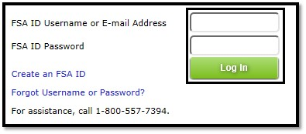
FSA ID
  Your FSA ID is a username and password that you must use to log in to certain U.S. Department of Education (ED) websites.
  Apply for your FSAID online at www.fsaid.ed.gov
  You will also create an FSAID password
  Like the PIN, the FSAID and password is required for both student and parent (if dependent) to electronically sign FAFSA

Slide 13
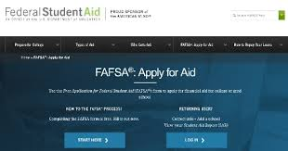
FAFSA
    What can you do on https://studentaid.gov/h/apply-for-aid/fafsa?
    Submit your FAFSA
    Retrieve IRS data
    Find college codes
    Add additional colleges
    Check status of FAFSA
    Make corrections to your information
    Print your Student Aid Report

Slide 14

FAFSA
IRS Data Retrieval
If indicate “Already Completed” taxes you will be prompted to use IRS data interface to retrieve your tax information
IRS data available for retrieval:
  2 to 3 weeks after federal tax forms
  filed electronically (70% of filers)
  8 to 11 weeks after paper federal tax
  forms filed (some have experienced
  longer delays)

Slide 15
FAFSA
IRS Data Retrieval
IRS data retrieval can be used:
  While completing original FAFSA
  As a later correction to FAFSA
Applicants will receive automatic reminder emails to go back to FAFSA and use IRS data retrieval if:
  They provided estimated tax figures on the FAFSA
  Provided actual tax figures on FAFSA but did not use IRS data retrieval
Items populated from IRS Data Retrieval:
Adjusted gross income
U.S. income taxes paid
Untaxed IRA distributions and/or pensions
IRA deductions
Tax exempt interest
Number of exemptions
Education credits
Student’s and parents’ income from work if:
  Marital status is other than married
  If ‘married’, total income from work from tax form will appear on screen and will need to separated by student or parent for entry into FAFSA fields

Slide 16

FAFSA
IRS Data Retrieval
To protect and enhance the security and privacy of personal data, all data retrieved by the IRS data retrieval tool is hidden from view on the IRS data retrieval website, FAFSA web pages, and the Student Aid Report (SAR).
When data is transferred, students and parents will only be able to see the words "transferred from the IRS" in the data entry fields on FAFSA, IRS web pages, and SAR.
Financial aid professionals will be able to view the IRS data.

Slide 17

Important Websites
FAFSA | fafsa.ed.gov
FSA User ID | fsaid.ed.gov
NYS TAP Application | tapweb.org
NYS Excelsior Scholarship Application | hesc.ny.gov
Direct Loan Processing | studentaid.gov/h/manage-loans
Federal Student Aid information | studentaid.gov
SUNY applicants | suny.edu/smarttrack

Slide 18
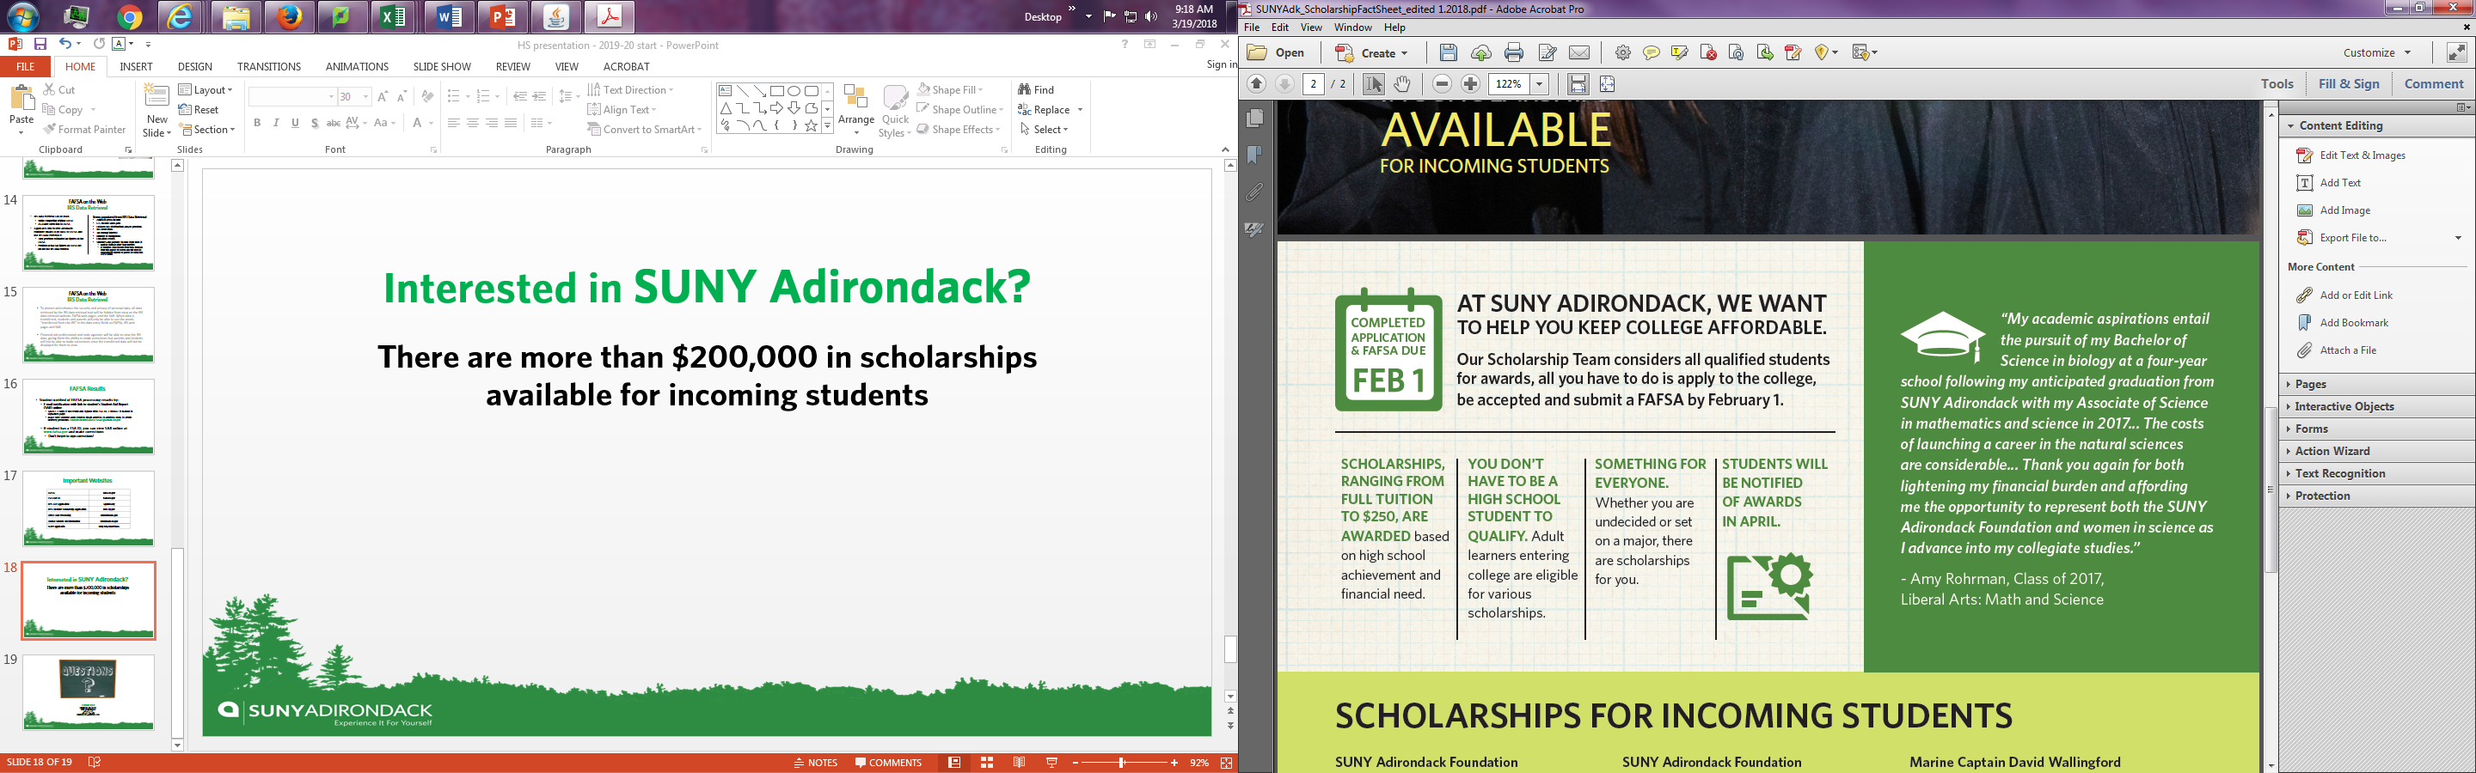
Interested in SUNY Adirondack?
*More than $400,000 in scholarships available for incoming
students*

Slide 19

Thank You!
Financial Aid Office
SUNY Adirondack
518-743-2188223
518-743-2314 fax
finaidoffice@sunyacc.edu

